Slide 1
Chapter One
Introduction to Operating System

Slide 2
Operating System
An Operating System (OS) is an interface between computer user and computer hardware.
An operating system is a software which performs all the basic tasks like file management, memory management, process management, handling input and output, and controlling peripheral devices such as disk drives and printers.
Some popular Operating Systems include Linux, Windows, OS X, VMS, OS/400, AIX, z/OS, etc.

Slide 3
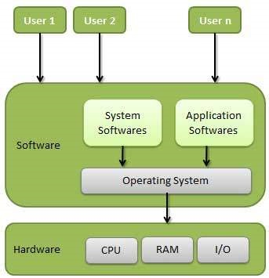
Operating System
An operating system is a program that acts as an interface/ intermediary between the user, software and the computer hardware, peripheral devices and controls the execution of all kinds of programs.

Slide 4
Layered Operating System
What is a layered operating system:
An operating system that has different types of layers for handling system software and user software is known as a layered operating system. The lower layers are responsible for handling core system software while the above layers are responsible for handling application software. A single layer can only interact with the layer above or below that layer.
Before the layered structure, there were two types of system:-
Monolithic structure (UNIX)
Simple structure (MS-DOS)
Examples of the layered operating system:-
Windows NT operating system

Slide 5
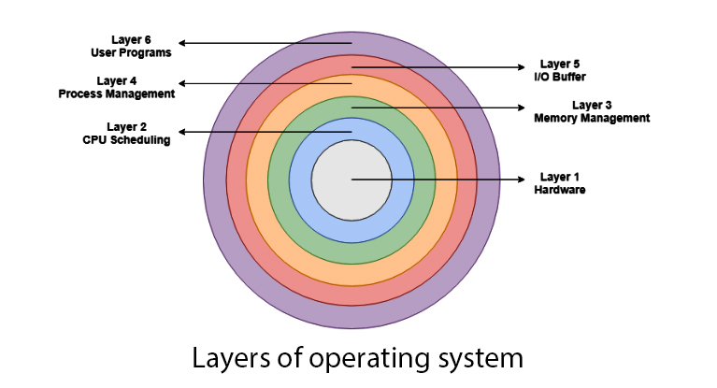

Slide 6
Layers of the operating system
Below are the layers of an operating system:-
Process management layer
In this layer, processes are managed i.e. which process is to be executed next and how many processes will stay in the waiting schedule. The priority of the processes is also managed in this layer.

Slide 7
User programs layer:
It can also be called an application layer because it is concerned with application programs. This type of layer is associated with the user programs like MS Word, Chrome, Calculator, Music Player etc. All the programs are managed in this layer.
CPU scheduling layer:
All the CPU (central processing unit) scheduling is managed in this layer.
This layer is responsible for managing how many processes will be allocated to the CPU and how many processes will stay out of the CPU.

Slide 8
Memory management layer
All memory management is associated with this layer. As you know there are various types of memories in the computer like RAM, ROM.
If you consider RAM (Random access memory) then it is concerned with swapping in and swapping out of memory. When our computer runs then some processes move to the main memory (RAM) for execution and when programs (e.g. calculator) exit then it is removed from the main memory.
These types of things are managed by this layer.

Slide 9
I/O buffer layer:
Suppose you are typing from the keyboard. There is a keyboard buffer attached with the keyboard which stores data for a temporary time.
Similarly, all input/output devices have some type of buffer attached to them. This is because the input/output devices have slow processing/storing speed.
To maintain the good timing speed of processor and input/output devices the computer uses buffers. The buffers are managed in this layer.

Slide 10
Hardware layer
There are various types of devices we attach with the computer e.g. keyboard, mouse, printer, scanner etc.
These types of hardware devices are managed in the hardware layer.
The hardware layer is the most authority layer and it is attached directly to the core of the system.

Slide 11
Functions of the Operating System
Following are some of important functions of an operating System.
Memory Management.
Processor Management.
Device Management.
File Management.
Security
Control over system performance
Job accounting
Error detecting aids
Coordination between other software and users
Booting
Loading and execution
Providing interface.

Slide 12
Interface Provision
It is used in order that the user interface acts with a computer manually.
User interface controls how you input data and instruction and how information is displayed on screen.
The operating system offers two types of the interface to the user:
Graphical-line interface: It interacts with visual environment to communicate with the computer. It uses windows, icons, menus and other graphical objects to issue commands.
Command-line interface: It provides an interface to communicate with the computer by typing commands.

Slide 13
Memory Management
Memory management refers to management of Primary Memory or Main Memory. Main memory is a large array of words or bytes where each word or byte has its own address.
Main memory provides a fast storage that can be accessed directly by the CPU. For a program to be executed, it must be in the main memory.
An Operating System does the following activities for memory management −
Keeps tracks of primary memory, i.e., what part of it are in use by whom, what parts are not in use.
In multiprogramming, the OS decides which process will get memory when and how much.
Allocates the memory when a process requests it to do so.
De-allocates the memory when a process no longer needs it or has been terminated.

Slide 14
Processor Management
In multiprogramming environment, the OS decides which process gets the processor when and for how much time. This function is called process scheduling.
An Operating System does the following activities for processor management −
Keeps tracks of processor and status of process. The program responsible for this task is known as traffic controller.
Allocates the processor (CPU) to a process.
De-allocates processor when a process is no longer required.

Slide 15
Device Management
An Operating System manages device communication via their respective drivers.
It does the following activities for device management −
Keeps tracks of all devices. Program responsible for this task is known as the I/O controller.
Decides which process gets the device when and for how much time.
Allocates the device in the efficient way.
De-allocates devices.

Slide 16
File Management
A file system is normally organized into directories for easy navigation and usage. These directories may contain files and other directions.
An Operating System does the following activities for file management −
Keeps track of information, location, uses, status etc. The collective facilities are often known as file system.
Decides who gets the resources.
Allocates the resources.
De-allocates the resources.

Slide 17
Communication
In case of distributed systems which are a collection of processors that do not share memory, peripheral devices, or a clock, the operating system manages communications between all the processes. Multiple processes communicate with one another through communication lines in the network.
The OS handles routing and connection strategies, and the problems of contention and security.
Following are the major activities of an operating system with respect to communication −
Two processes often require data to be transferred between them
Both the processes can be on one computer or on different computers, but are connected through a computer network.
Communication may be implemented by two methods, either by Shared Memory or by Message Passing.

Slide 18
Error handling
Errors can occur anytime and anywhere. An error may occur in CPU, in I/O devices or in the memory hardware.
Following are the major activities of an operating system with respect to error handling −
The OS constantly checks for possible errors.
The OS takes an appropriate action to ensure correct and consistent computing.

Slide 19
Resource Management
In case of multi-user or multi-tasking environment, resources such as main memory, CPU cycles and files storage are to be allocated to each user or job.
Following are the major activities of an operating system with respect to resource management
The OS manages all kinds of resources using schedulers.
CPU scheduling algorithms are used for better utilization of CPU.

Slide 20
Protection
Considering a computer system having multiple users and concurrent execution of multiple processes, the various processes must be protected from each other's activities.
Protection refers to a mechanism or a way to control the access of programs, processes, or users to the resources defined by a computer system.
Following are the major activities of an operating system with respect to protection
The OS ensures that all access to system resources is controlled.
The OS ensures that external I/O devices are protected from invalid access attempts.
The OS provides authentication features for each user by means of passwords.

Slide 21
Other Important Activities
Following are some of the important activities that an Operating System performs
Security − By means of password and similar other techniques, it prevents unauthorized access to programs and data.
Control over system performance − Recording delays between request for a service and response from the system.
Job accounting − Keeping track of time and resources used by various jobs and users.
Error detecting aids − Production of dumps, traces, error messages, and other debugging and error detecting aids.
Coordination between other software and users − Coordination and assignment of compilers, interpreters, assemblers and other software to the various users of the computer systems.

Slide 22
Classifications of Operating Systems
Single-User Operating Systems:
Designed to support one user at a time.
Commonly used on personal computers and workstations.
Multi-User Operating Systems:
Supports multiple users simultaneously.
Used in environments where multiple users need access to the system resources concurrently.
Single-Tasking and Multi-Tasking Operating Systems:
Single-tasking OS allows only one task to run at a time.
Multi-tasking OS allows multiple tasks to run concurrently.

Slide 23
Classification of Operating System
Operating systems can be categorized according to availability, number of users, type of interface design and manufacturer:
According to availability
Real-time operating systems
Non-real-time operating Systems
According to number of users
Single-User/Single-Tasking Operating Systems
Single-User/Multi-Tasking Operating Systems
Multi-User/Multitasking Operating Systems

Slide 24
Classification of Operating System
According to interface design
Command line interface
Graphical user interface
According to manufacturer
Microsoft Windows operating systems
Linux
Mac OS etc.

Slide 25
Classification of Operating System
Single-User/Single-Tasking Operating Systems:
Allows a single user to perform just one task at a time
Take up little space on disk
Run on inexpensive computers
Examples include; MS-DOS and Palm OS for palm handheld computers.
Single-User/Multi-Tasking Operating Systems:
Allows a single user to perform two or more functions at once.
Commonly used on personal computers.
Examples include; Microsoft Windows and MAC OS.

Slide 26
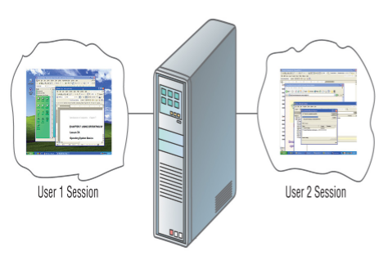
Classification of Operating System
Multi-User/Multitasking Operating Systems:
Allows multiple users to use programs that are simultaneously running on a single network server.
Here, each user is given a user session on the server.
UNIX, Linux are examples.
Maintenance can be easy.
It Requires a powerful computer.

Slide 27
Classification of Operating systems
Batch Processing and Real-Time Operating Systems:
Batch processing OS processes a set of tasks without user intervention.
Real-time OS is designed for applications with strict timing requirements.
Distributed Operating Systems:
Runs on multiple machines and enables them to work together as a single system.
Facilitates resource sharing and load balancing.
Notes:
Each user prepares his job on an off-line device like punch cards and submits it to the computer operator. To speed up processing, jobs with similar needs are batched together and run as a group. The programmers leave their programs with the operator and the operator then sorts the programs with similar requirements into batches.
Time-sharing is a technique which enables many people, located at various terminals, to use a particular computer system at the same time. Time-sharing or multitasking is a logical extension of multiprogramming. Processor's time which is shared among multiple users simultaneously is termed as time-sharing.

Slide 28
Distributed operating System
Distributed systems use multiple central processors to serve multiple real-time applications and multiple users. Data processing jobs are distributed among the processors accordingly.
The processors communicate with one another through various communication lines (such as high-speed buses or telephone lines).
These are referred as loosely coupled systems or distributed systems. Processors in a distributed system may vary in size and function. These processors are referred as sites, nodes, computers, and so on.

Slide 29
The advantages of distributed systems
With resource sharing facility, a user at one site may be able to use the resources available at another.
Speedup the exchange of data with one another via electronic mail.
If one site fails in a distributed system, the remaining sites can potentially continue operating.
Better service to the customers.
Reduction of the load on the host computer.
Reduction of delays in data processing.

Slide 30
Network operating System
A Network Operating System runs on a server and provides the server the capability to manage data, users, groups, security, applications, and other networking functions.
The primary purpose of the network operating system is to allow shared file and printer access among multiple computers in a network, typically a local area network (LAN), a private network or to other networks.
Examples of network operating systems include:
Microsoft Windows Server 2003, Microsoft Windows Server 2008,2012, UNIX, Linux, Mac OS X, Novell NetWare, and BSD.

Slide 31
Advantages of network operating systems
Centralized servers are highly stable.
Security is server managed.
Upgrades to new technologies and hardware can be easily integrated into the system.
Remote access to servers is possible from different locations and types of systems.

Slide 32
Disadvantages of network operating systems
High cost of buying and running a server.
Dependency on a central location for most operations.
Regular maintenance and updates are required.

Slide 33
Real Time operating System
A real-time system is defined as a data processing system in which the time interval required to process and respond to inputs is so small that it controls the environment.
The time taken by the system to respond to an input and display of required updated information is termed as the response time. So in this method, the response time is very less as compared to online processing.
Real-time systems are used when there are rigid time requirements on the operation of a processor or the flow of data and real-time systems can be used as a control device in a dedicated application. A real-time operating system must have well-defined, fixed time constraints, otherwise the system will fail. For example, scientific experiments, medical imaging systems, industrial control systems, weapon systems, robots, air traffic control systems, etc.

Slide 34
Types of real-time operating systems.
Hard real-time systems
Hard real-time systems guarantee that critical tasks complete on time. In hard real-time systems, secondary storage is limited or missing and the data is stored in ROM. In these systems, virtual memory is almost never found.
Soft real-time systems
Soft real-time systems are less restrictive. A critical real-time task gets priority over other tasks and retains the priority until it completes. Soft real-time systems have limited utility than hard real-time systems. For example, multimedia, virtual reality, advanced Scientific Projects like undersea exploration and planetary rovers, etc.

Slide 35
Classification of Operating System
The two most common types of user interfaces are graphical and command line.
1) Graphical user Interfaces (GUI):
Most common interface used in versions of;
Windows, MAC OS, in some versions of LINUX and UNIX.
Uses a mouse to work with graphical objects such as windows, menus, icons, buttons and other tools.
Advantage
It frees a computer user from memorizing and typing text commands.
It is user friendly
Can use Shortcuts to open programs or documents.
It enables task switching.
However
It takes up a large disk space
It consumes a lot of memory
It is less secure than Command Line Interface.
Notes:
Types of an operating system
Real-Time operating Systems (RTOS): - -Very first, relatively small OS. - -Also referred to as embedded OSs - -Built into a circuitry of a device, not loaded from a disk drive - -RTOS is needed to run real-time applications. - -A real time application is an application that responds to certain inputs extremely quickly. - -As the name suggests, there is a deadline associated with tasks and a RTOS adheres to this deadline as missing a deadline can cause affects ranging from undesired to catastrophic. Types of an operating system

Slide 36
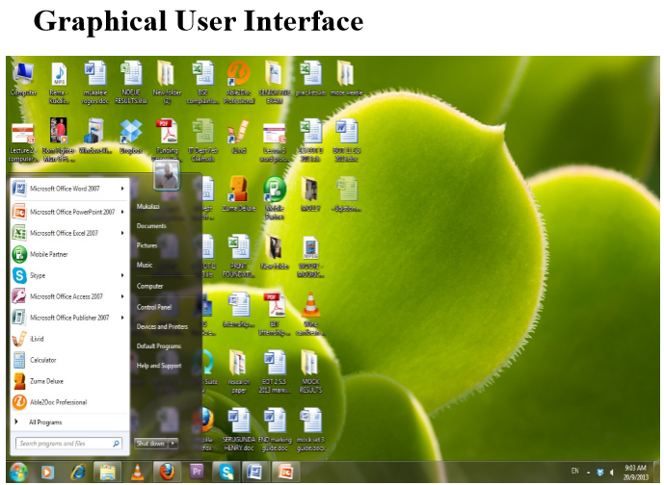

Slide 37
Graphical User Interface
The User Interface -GUI Tools
Icons are pictures that represent computer resources, such as printers, documents and programs.
You double-click an icon to choose (activate) it, for instance, to launch a program.
The Windows operating system offers two unique tools, called the taskbar and Start button which help you run and manage programs.
A menu groups related commands. For example, the File menu's commands let you open, save, and print document files.
In programs designed for the same GUI, menus and commands are similar from one program to another.

Slide 38
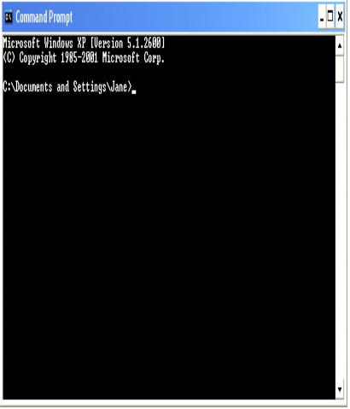
Command Line Interface
Older interface used in MS-DOS, Linux, UNIX
User types commands at a prompted to execute tasks.
User must remember all commands.
It is secure, reliable and stable.
Windows also has an optional command prompt that can be used by administrators to run non-GUI programs for managing and troubleshooting windows.

Slide 39
Types of Operating system
Windows:
Developed by Microsoft, commonly used on personal computers.
Linux:
Open-source OS kernel used in various distributions (distros).
Widely used in servers and embedded systems.
MacOS:
Developed by Apple, used on Macintosh computers.
UNIX:
A powerful, multi-user, and multitasking operating system.
Used in servers, workstations, and mainframes.
Android:
A mobile operating system based on the Linux kernel.
iOS:
Developed by Apple, used on iPhones and iPads.
RTOS (Real-Time Operating System):
Designed for real-time applications with precise timing requirements.

Slide 40
Operating systems programs
Operating systems consist of various programs and components that work together to manage the computer's resources and provide a platform for running applications. Here are some essential programs and components found in operating systems:
Kernel
The core component of the operating system that manages hardware resources.
Responsible for process management, memory management, device management, and system calls.
Shell
A command-line interface or user interface that allows users to interact with the operating system by entering commands.
Examples include the Command Prompt in Windows or the Terminal in Unix-like systems.
Device Drivers
Programs that facilitate communication between the operating system and hardware devices.
Ensures proper functioning of peripherals like printers, graphics cards, and network adapters.

Slide 41
Operating systems programs
File System Drivers
Manage the file systems on storage devices, allowing the OS to read, write, and organize files.
Examples include NTFS, FAT32, and ext4 file system drivers.
System Libraries
Collections of pre-compiled code used by applications to perform common tasks.
Provide functions like input/output operations, mathematical computations, and networking.
Init System
The first process that starts during system boot-up.
Manages the initialization of system processes and services.
User Interface Components
Components responsible for presenting information to users and receiving input.
Graphical user interfaces (GUIs) use components like window managers, desktop environments, and graphical shells.

Slide 42
Operating systems programs
System Calls
Interfaces between user-level applications and the kernel.
Allow applications to request services from the operating system, such as process creation or file access.
Task Scheduler
Manages the execution of processes, determining which tasks should run and when.
Uses scheduling algorithms to optimize resource utilization.
Memory Manager
Allocates and deallocates memory for processes.
Manages virtual memory to provide an illusion of more extensive memory than physically available.
Security Components
User authentication mechanisms to control access.
Security policies, firewalls, and encryption to protect the system and data.

Slide 43
Operating systems programs
Networking Stack
Manages network connections and communication.
Implements protocols like TCP/IP for data transfer.
Utilities
System utilities provide various tools for system management and maintenance.
Examples include disk cleanup tools, system monitoring tools, and backup utilities.
Updater/Package Manager
Manages the installation, updating, and removal of software packages.
Ensures that the operating system and installed software are kept up-to-date.
Error Handling and Logging
Detects and logs errors and events for troubleshooting purposes.
Helps diagnose and resolve issues within the system.

Slide 44
Multitasking
Multitasking is when multiple jobs are executed by the CPU simultaneously by switching between them. Switches occur so frequently that the users may interact with each program while it is running.
An OS does the following activities related to multitasking
The user gives instructions to the operating system or to a program directly, and receives an immediate response.
The OS handles multitasking in the way that it can handle multiple operations/executes multiple programs at a time.
Multitasking Operating Systems are also known as Time-sharing systems.
These Operating Systems were developed to provide interactive use of a computer system at a reasonable cost.
A time-shared operating system uses the concept of CPU scheduling and multiprogramming to provide each user with a small portion of a time-shared CPU.
Each user has at least one separate program in memory.

Slide 45
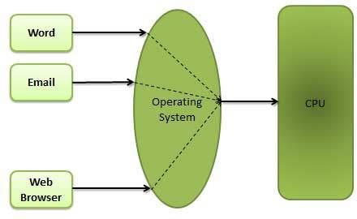
Multitasking

Slide 46
Multitasking
A program that is loaded into memory and is executing is commonly referred to as a process.
When a process executes, it typically executes for only a very short time before it either finishes or needs to perform I/O.
Since interactive I/O typically runs at slower speeds, it may take a long time to complete. During this time, a CPU can be utilized by another process.
The operating system allows the users to share the computer simultaneously. Since each action or command in a time-shared system tends to be short, only a little CPU time is needed for each user.
As the system switches CPU rapidly from one user/program to the next, each user is given the impression that he/she has his/her own CPU, whereas actually one CPU is being shared among many users.

Slide 47
Multiprogramming
Sharing the processor, when two or more programs reside in memory at the same time, is referred as multiprogramming. Multiprogramming assumes a single shared processor. Multiprogramming increases CPU utilization by organizing jobs so that the CPU always has one to execute.

Slide 48
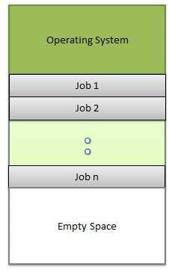
The following figure shows the memory layout for a multiprogramming system.

Slide 49
An OS does the following activities related to multiprogramming.
The operating system keeps several jobs in memory at a time.
This set of jobs is a subset of the jobs kept in the job pool.
The operating system picks and begins to execute one of the jobs in the memory.
Multiprogramming operating systems monitor the state of all active programs and system resources using memory management programs to ensure that the CPU is never idle, unless there are no jobs to process.

Slide 50
Advantages
High and efficient CPU utilization.
User feels that many programs are allotted CPU almost simultaneously.
Disadvantages
CPU scheduling is required.
To accommodate many jobs in memory, memory management is required.

Slide 51
Spooling
Spooling is an acronym for simultaneous peripheral operations on line. Spooling refers to putting data of various I/O jobs in a buffer. This buffer is a special area in memory or hard disk which is accessible to I/O devices.
An operating system does the following activities related to distributed environment −
Handles I/O device data spooling as devices have different data access rates.
Maintains the spooling buffer which provides a waiting station where data can rest while the slower device catches up.
Maintains parallel computation because of spooling process as a computer can perform I/O in parallel fashion. It becomes possible to have the computer read data from a tape, write data to disk and to write out to a tape printer while it is doing its computing task.

Slide 52
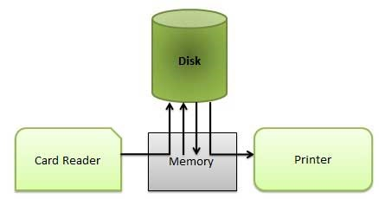
Spooling
Advantages
The spooling operation uses a disk as a very large buffer.
Spooling is capable of overlapping I/O operation for one job with processor operations for another job.

Slide 53
Personal Computers Operating Systems
DOS(Disk Operating System)
It supports one user and one program at a time. In other words it is s a Single user, single-task OS
Uses a Command line interface
Supports only 16-bit programs yet most modern programs are either 32-bit or 64-bit.
Oldest operating system.
Advantages of using DOS:
It doesn't require much memory or storage space
Doesn’t require a powerful computer.

Slide 54
Personal Computers Operating Systems
Microsoft Windows:
Microsoft created the Windows operating system in the mid1980s.
Earlier windows versions include windows 3.0, 3.1, windows 95, 98, 2000, windows NT and many more.
Most popular versions are Windows 7(released in 2009),Windows Vista(2007), and Windows XP(2001).
It comes preloaded on most new PCs, which helps to make it the most popular operating system in the world
Mostly Graphical user Interface.
Latest windows versions have additional features such as; Digital Media support, Advanced Networking and Communications, Advanced Mobile Computing.

Slide 55
Personal Computers Operating Systems
Macintosh Operating System(Mac OS):
Used on Apple machines.
It comes preloaded on all new Macintosh computers, or Macs.
All of the recent versions are known as Mac OS X(pronounced Mac O-S Ten), and their specific version names are Lion (released in 2011), Snow Leopard (2009) and Leopard (2007).
Apple also offers a version called Mac OS X Server, which is designed to be run on servers.
Apple computers tend to be more expensive this is why Mac OS X users are very few compared to Windows users ( which are over 90%).

Slide 56
Personal Computers Operating Systems
Linux
It is a 32-bit/64-bit OS that supports multiple users and multiple processes at the same time.
It is a free or inexpensive version of UNIX.
It is very stable, fast and secure.
Mostly uses a command line interface but also has a GUI environment.
It is Open Source which means that it can be modified and distributed by anyone around the world.
The most popular Linux distributions include Ubuntu, Mint, and Fedora.

Slide 57
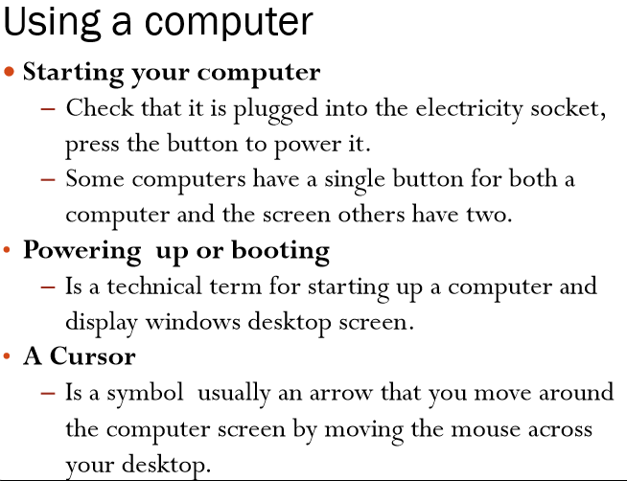
Windows Operating System Basics

Slide 58
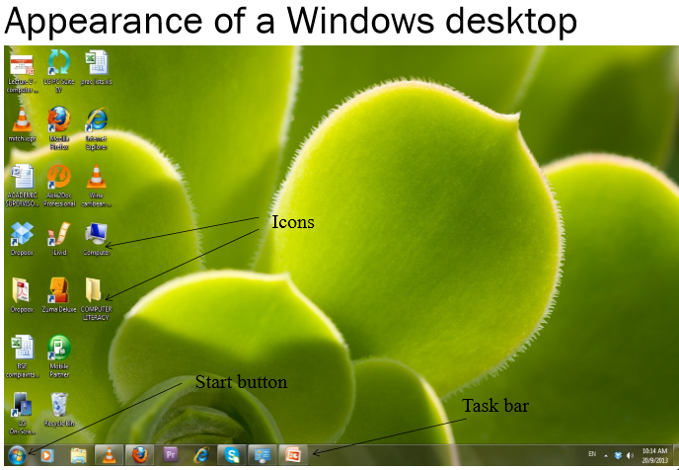

Slide 59
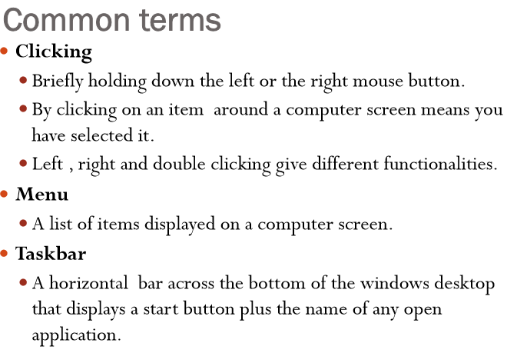

Slide 60
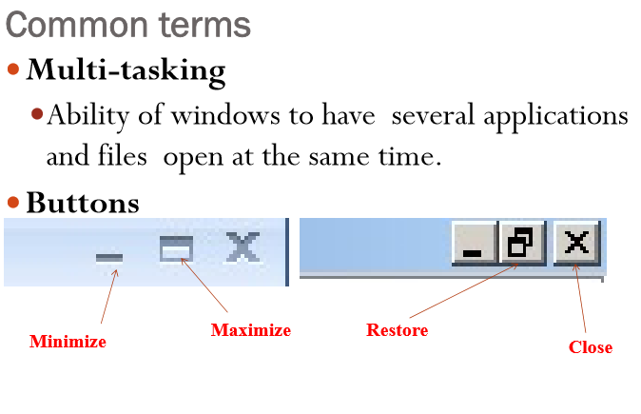

Slide 61
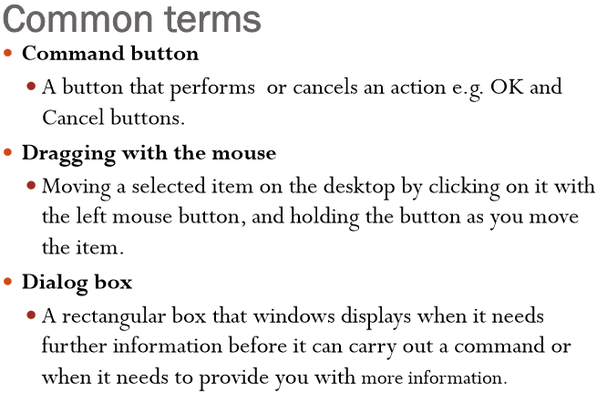

Slide 62
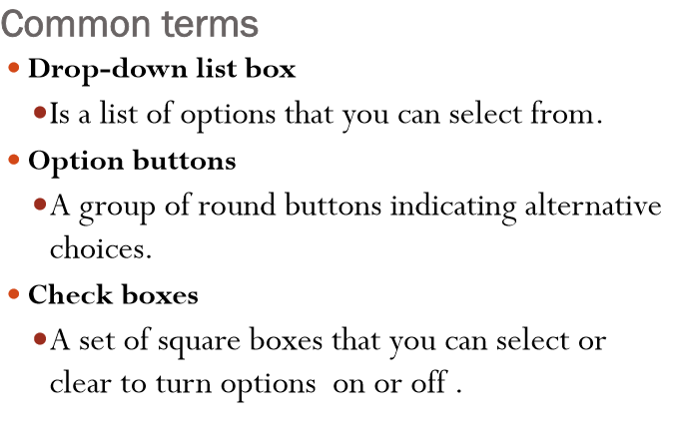

Slide 63
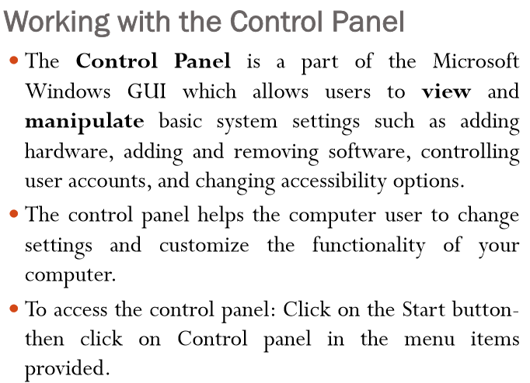

Slide 64
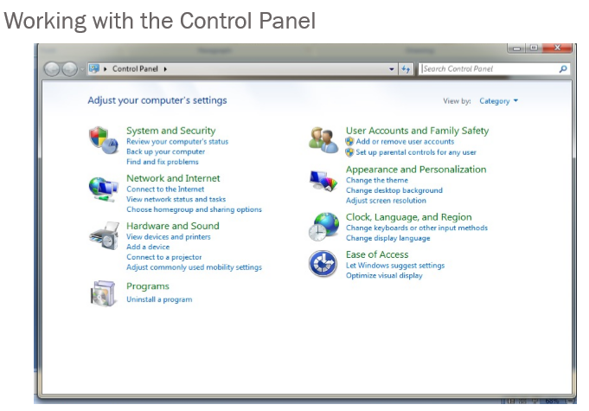

Slide 65
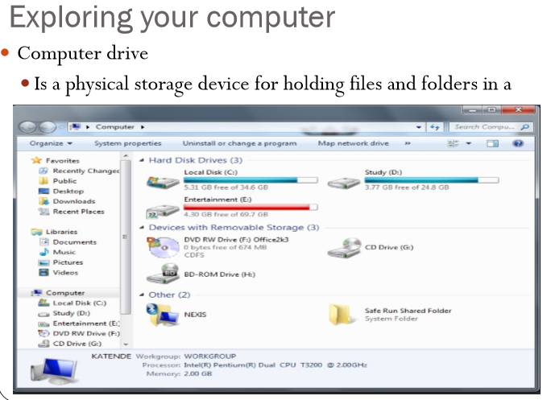

Slide 66
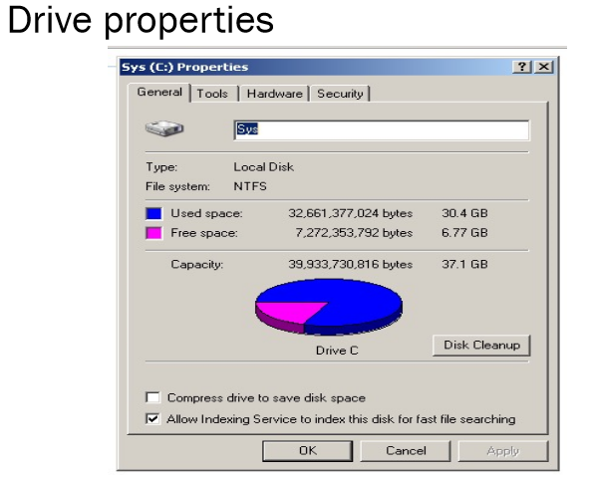

Slide 67
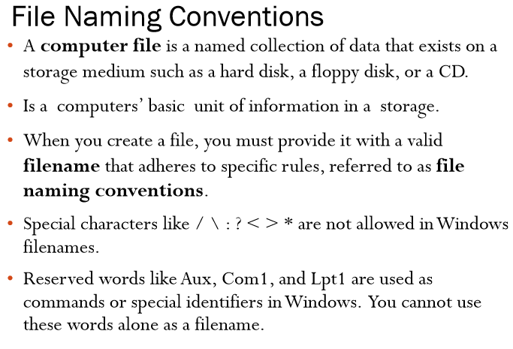

Slide 68
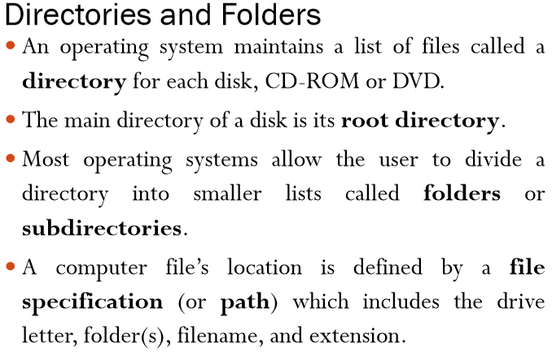

Slide 69
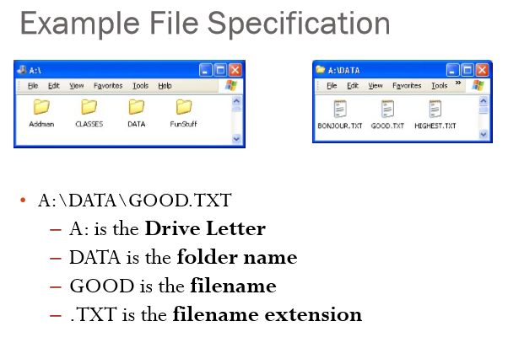

Slide 70
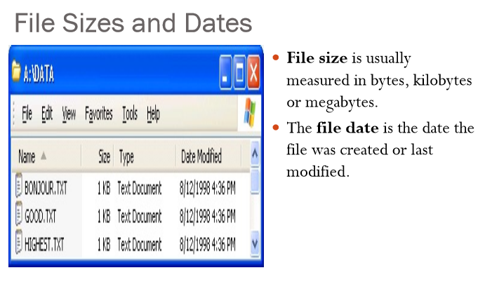

Slide 71
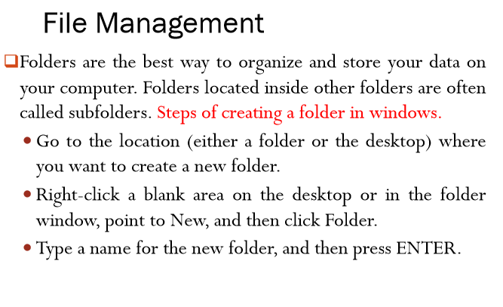

Slide 72
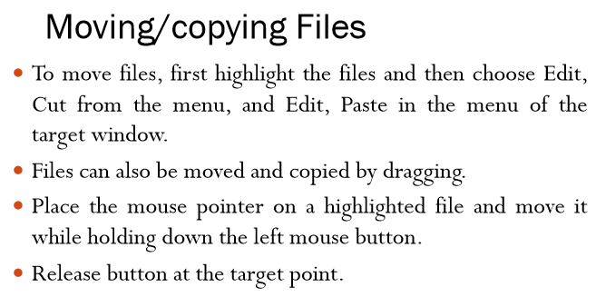

Slide 73
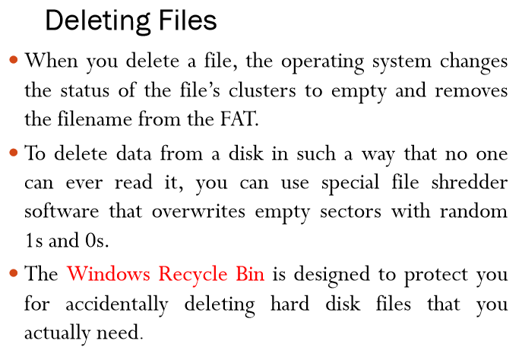

Slide 74
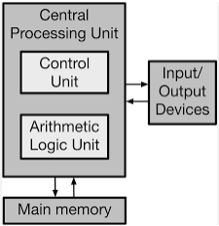
Computer System Structure
The main components of the basic structure of computers are the control processing unit (CPU), an input unit, memory unit, control unit, and output unit. Ans. The main functions performed by computers based on their basic structure include output, input, storage, and processing.

